Slide 1
Social Innovation: from global to local

Slide 2
CONTENT
A Global view
Local - A South African view

Slide 3
The bottom line is clear: Solutions to America’s challenges are being developed every day at the grass roots – and government shouldn’t be supplanting these efforts, it should be supporting these efforts
Notes:
Policy interest – In the United States, President
Obama established theOffice of Social Innovation and Civic Participation within
theWhiteHouse in 2009 ostensibly to engage citizens and civil society to find new
ways to solve social problems. At the European level, social innovation cuts across
a range of policy areas and was developed under the Social Innovation Initiative
with the aim of mainstreaming social innovation policies through the Horizon
2020 strategic framework for research and innovation

Slide 4
Social Innovation in Practice
Notes:
Practitioner interest: Hubs etc….

Slide 5
Growth in social innovation publications from 1989-2013
Notes:
Source Ayob et al. 2016
Academic interest

Slide 6
De-contestation of social innovation?
Notes:
Source Ayob et al 2016 social innovation as contested concept whose various meanings have converged over time

Slide 7
Social innovation as process
New forms of social relations
Innovation
New forms of power relations
Utilitarian social value
Notes:
Source Ayob et al 2016

Slide 8
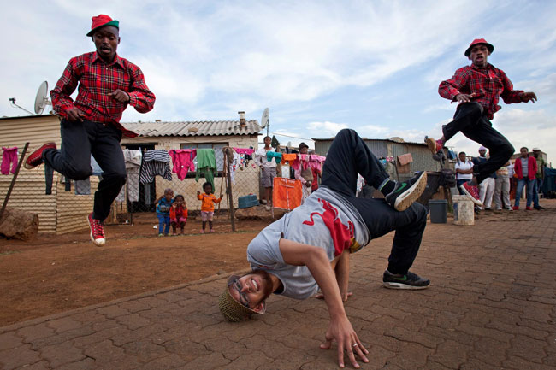
Social Innovation in South Africa

Slide 9
SI in SA ?
Terminological Tension [Social Entrepreneurship (SE)
vs. Social Innovation(SI)]

Slide 10
The Social Innovation Environment: Policy Conundrum
SI more encompassing than SE with broad(er) policy implications
Target areas for policy attention:
Tax environment
Corporate legal structures (hybrid modelling)
SMME Development
Public/private procurement & partnerships
B-BBEE (Enterprise development)
Accreditation (B-Corp) & NGO
Investment models (Impact investment)
Microfinancing
Triple bottom line
Notes:
Source: Rediscovering Social Innovation, Phills et al.(2008)

Slide 11
Funding Models for the Social Innovation Environment
Urgent need to move away from traditional funding paradigms (debt; equity; grants) moving toward Blended Funding Models
Innovative Finance? (Funding enterprises and investments creating social and environmental impact – combining social and financial investment)
Venture Philanthropy(Allen & Gill Gray Foundation)
Social Impact Bonds (SIB)/Development Impact Bonds (DIB)(Outcomes-based financing partnerships – ECD/Western Cape Dept. of Health)
Microfinance (MFSA)
Social Stock Exchanges (SASIX)
Social Fundraising/Crowdfunding (THUNDAFUND)
Notes:
Source: Innovative Finance in Africa – Bertha Centre for Social Innovation & Entrepreneurship Flanders Study (2015) , Brookings Institute (2016)

Slide 12
14 of the more prominent
SA Social Entrepreneurs
SHARANJEET
KOVIN
JONATHAN
non for profit
For profit
Mission Driven
Mission & Profit Driven
Profit Driven
Notes:
BUSINESS MODEL plotted on a the for-profit - not-for-profit spectrum – Book: The Disruptors – Social Entrepreneurs reinventing business and society (2016)

Slide 13
A Global Perspective on South African Social Entrepreneurship
‘Impact Investors emerging in SA,… however most SE’s do not yet have a scalable or sustainable business …..’
Social Impact
Social Innovation
Financial
Sustainability
Measurement
SA Social entrepreneurs are intent on having social impact not just an afterthought
‘SA social entrepreneurs have been requested to be more definitive about how they measure social impact.’
Innovation in Business Models (spanning non-profit through for-profit)
Service –Delivery Model (connect people and resources)
Technological Model (address social and enviro issues)
Notes:
A extract of the article Robinson and Gilbert from Rutgers Business School (2016) discussed - The Process of social entrepreneurship

Slide 14
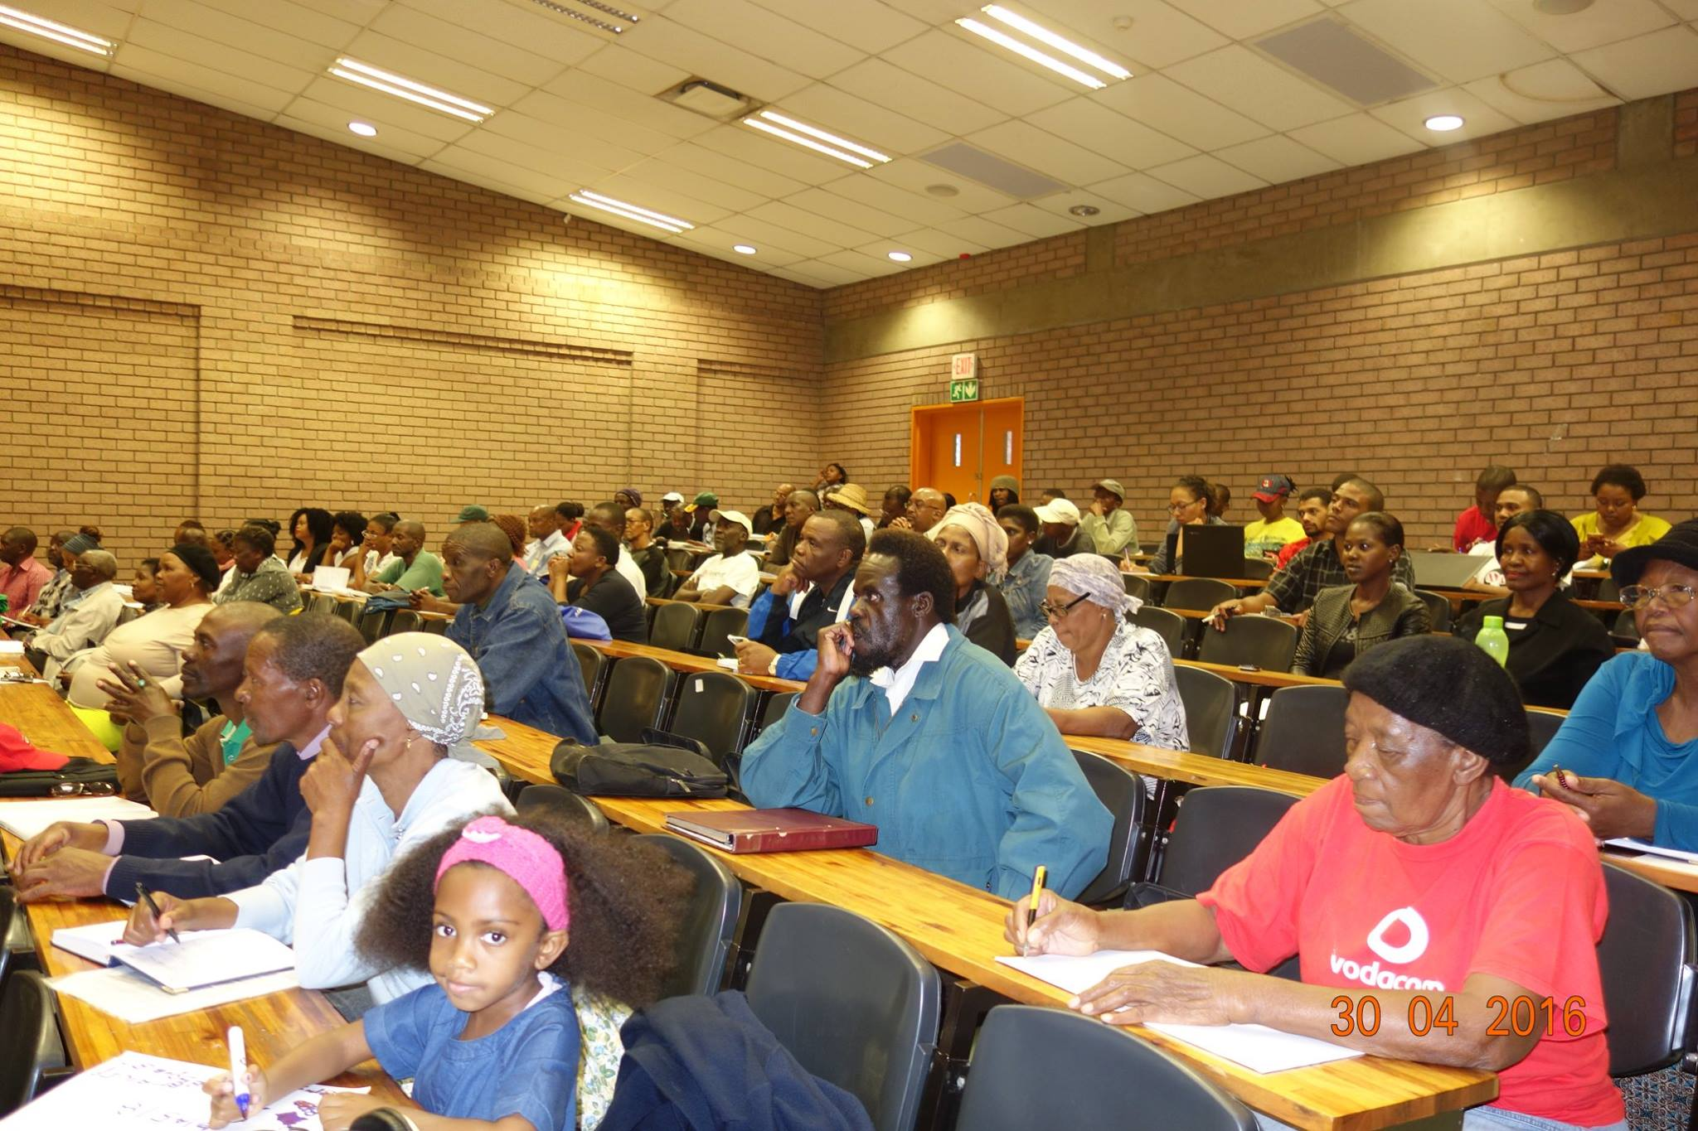
SOCIAL INNOVATION
is a novel solution to a social problem that is more effective, efficient, sustainable, or just than current solutions. The value created accrues primarily to society rather than to private individuals
Urban Farmers: Food Conversations
Notes:
Source: Stanford Graduate School of Business

Slide 15
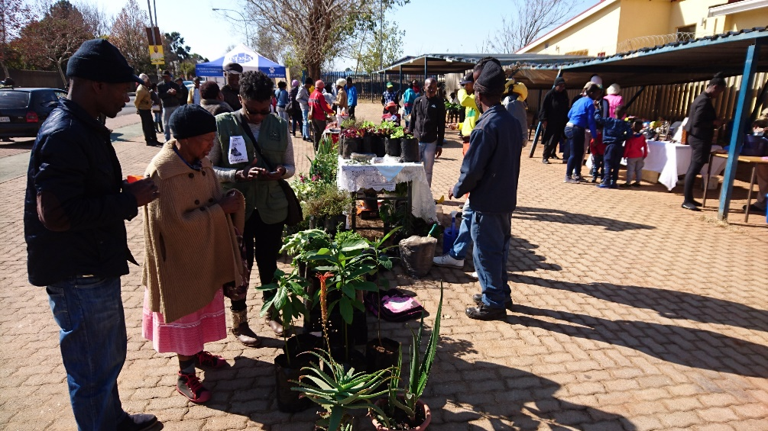
Creating Social Value …..
An urban farmer network that promotes organic farming (Izindaba Zokudla) it also creates a market for farmers and therefore creating employment for the elderly and less educated.

Slide 16
The Processes….
Creating technology to assist farmers via green-week where students volunteer their time and resources

Slide 17
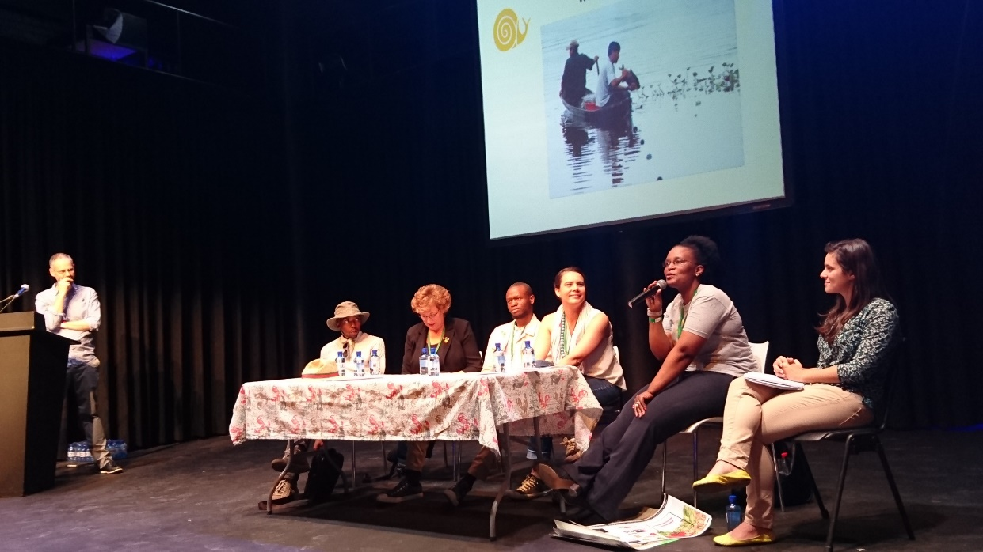
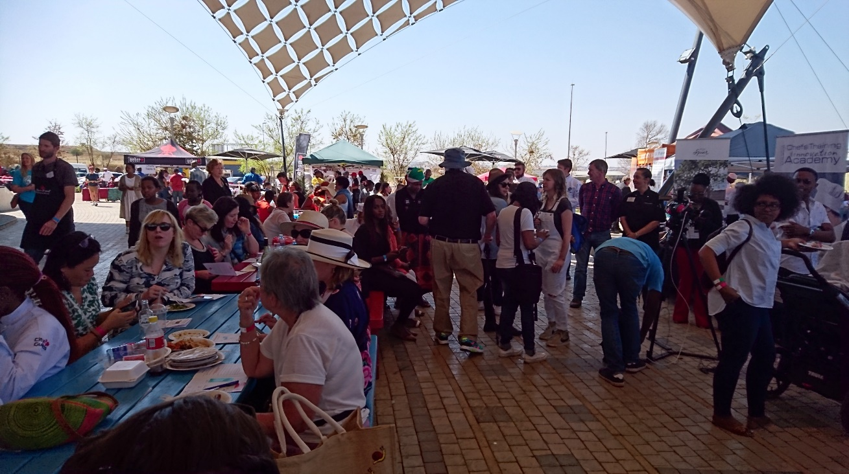
For the community…..
Sharing best practices involving the academics, practitioners and the community

Slide 18
DRIVING FORCE
Exchange of ideas and values
Shifts in roles and relationships
Integration of private capital with public and philanthropic support

Slide 19
THANK YOU
Work Group : Social Innovation
Glasgow Caledonian University (GCU)
University of Johannesburg (UJ)
University of Free State (UFS)
Roskilde University (RUC)

